Slide 1
Whole-School Assembly
Whole-School Assembly | Children’s Mental Health Week | Find Your Brave

Slide 3
Aim
To explore what mental health is, how we can look after our mental health and what ‘being brave’ really means.

Slide 4
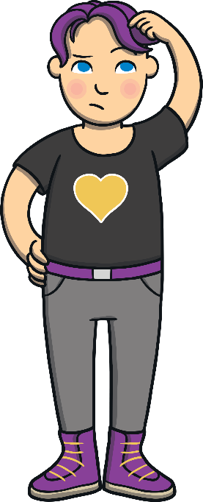
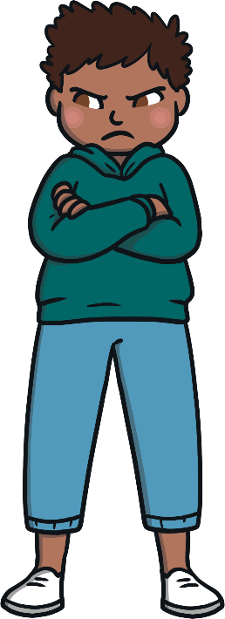
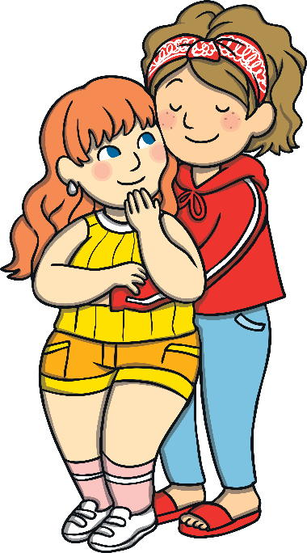
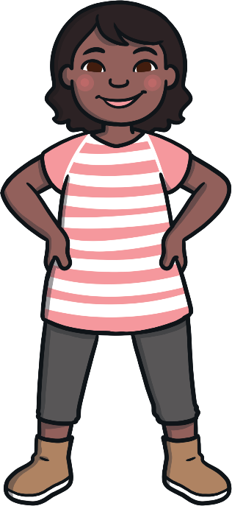
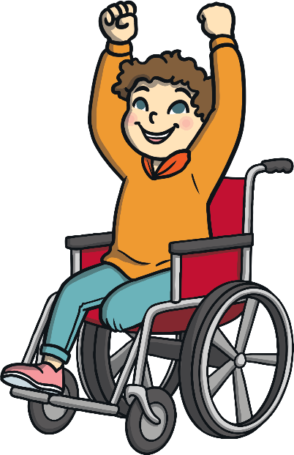
What Is Mental Health?
We can all try to 'find our brave' during hard times.
Mental health is all about how we are feeling and the thoughts we are having. It can affect how we behave and the choices we make.

Slide 5
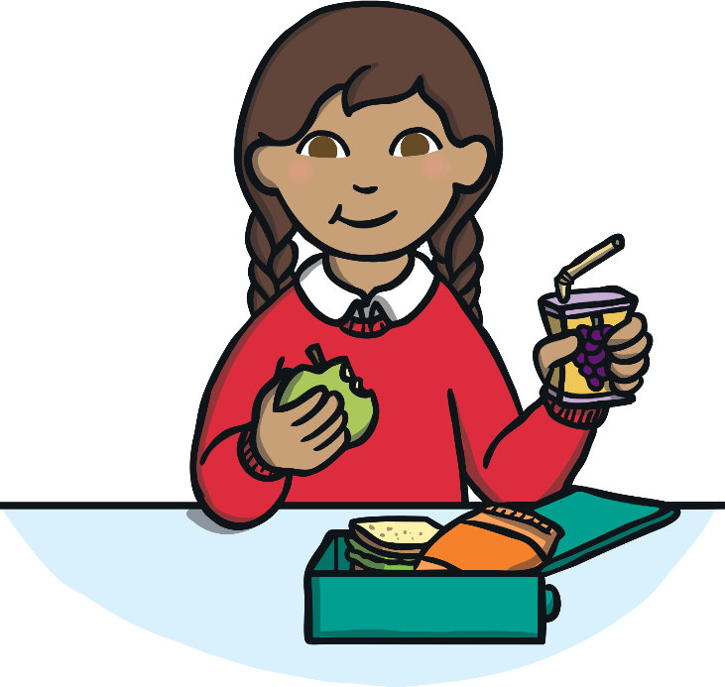
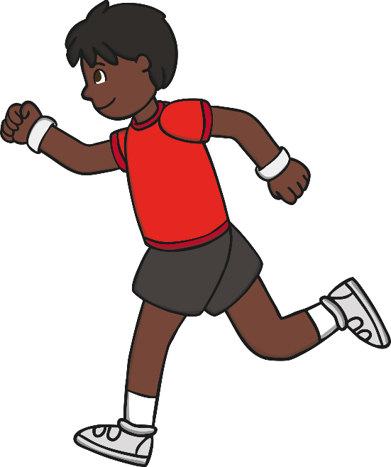
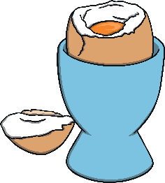
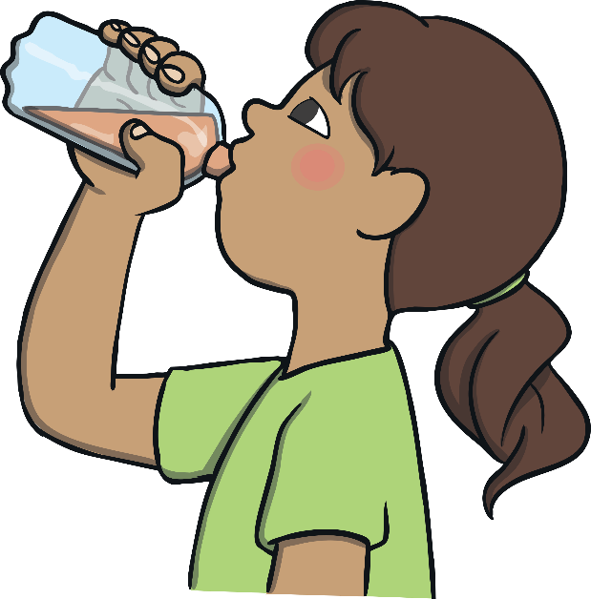
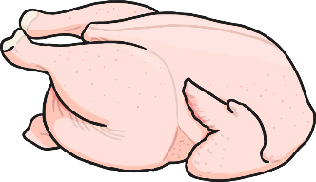
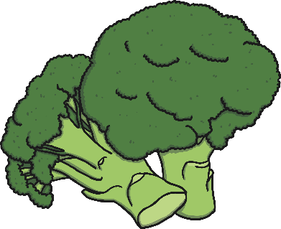
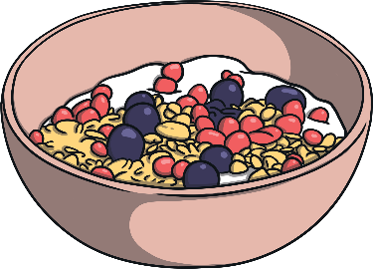
How Can We Look after Our Mental Health?
Just as we do for our bodies, it is important to do things that help our minds to stay healthy and feel well.
How many different things can you spot that we can do to look after our mental health?

Slide 6
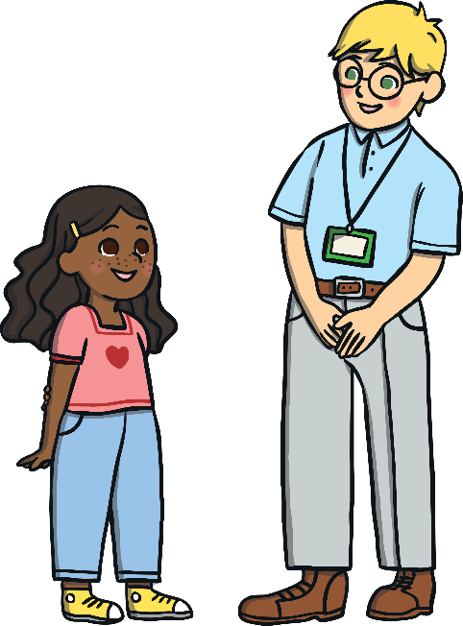
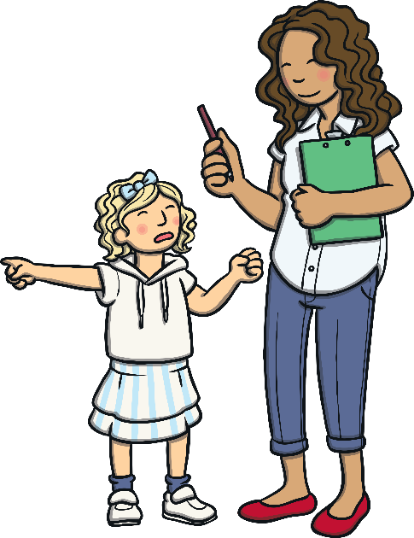
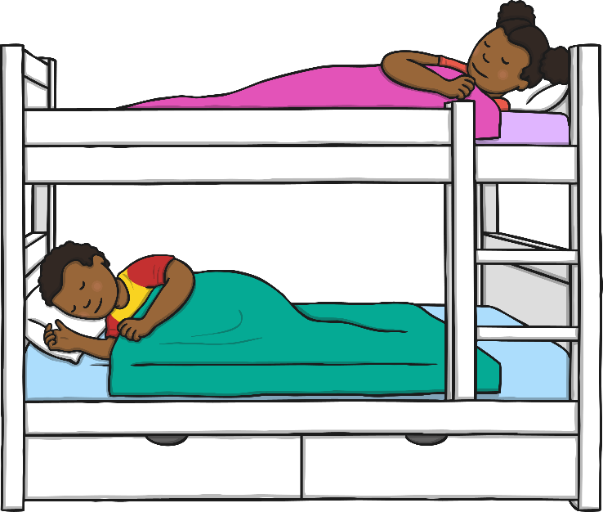
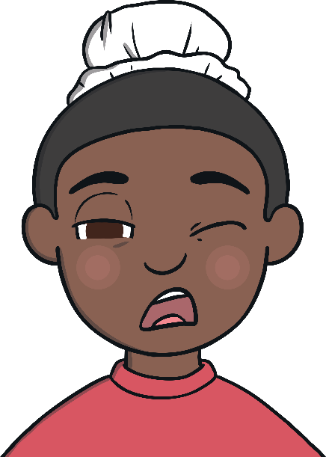
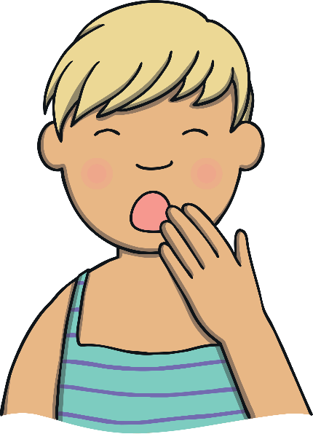
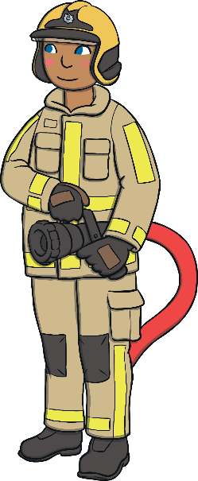
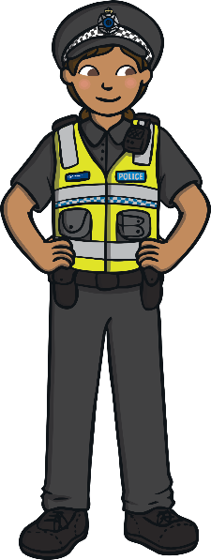
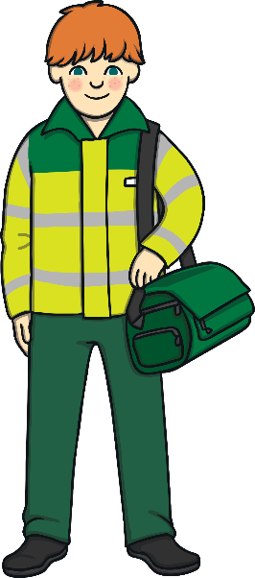
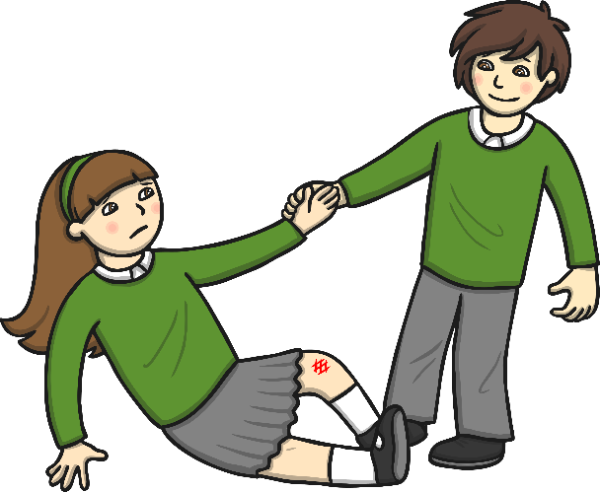
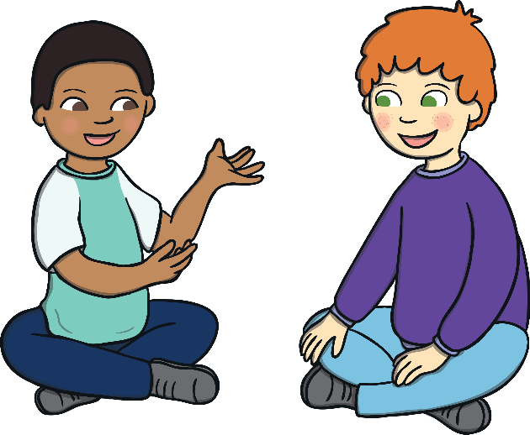
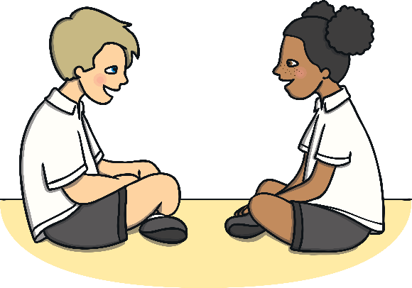
How Can We Look after Our Mental Health?
Just like with our body, it is important that we do things to help our minds to be healthy, be in good condition and feel well.
How many different things can you spot that we can do to look after our mental health?

Slide 7
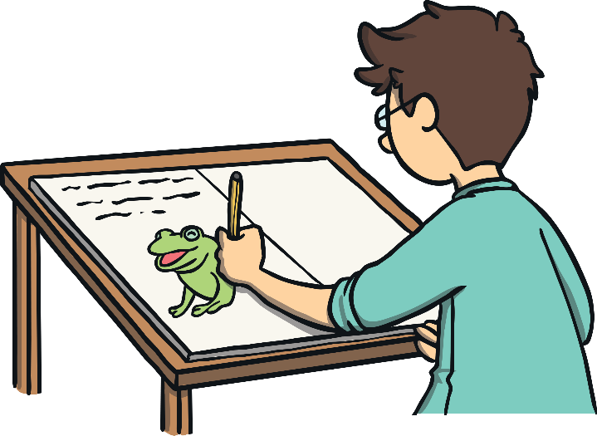
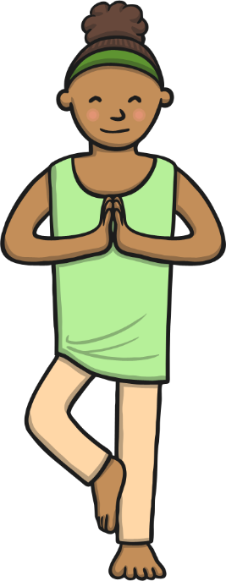
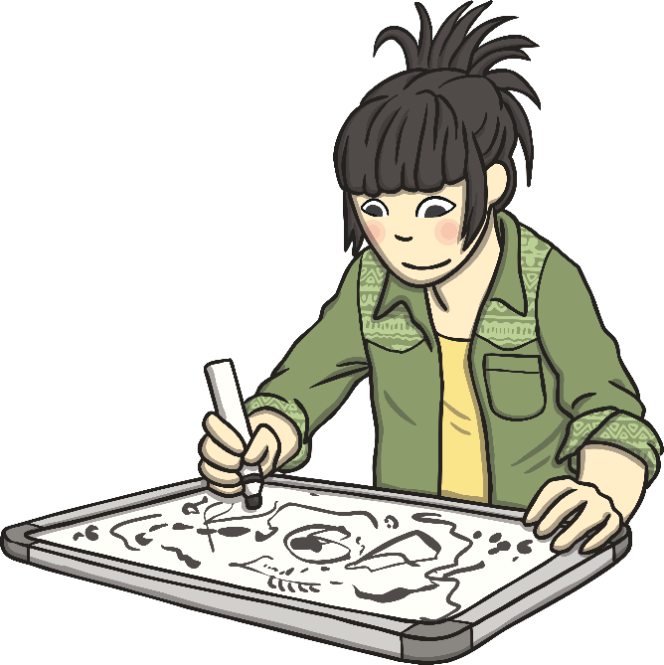
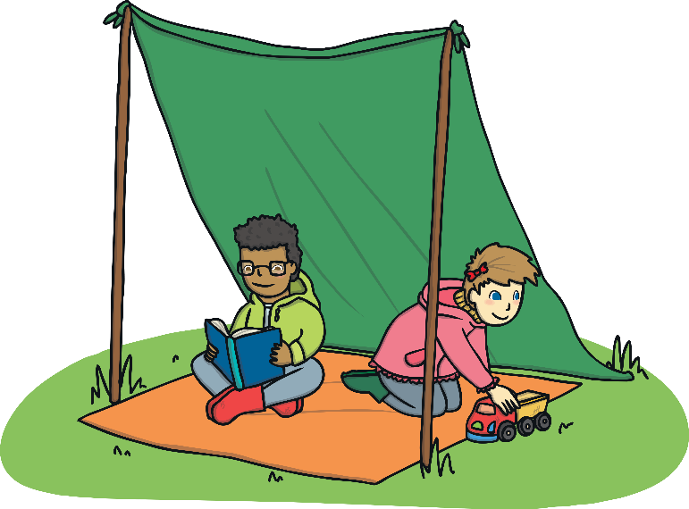
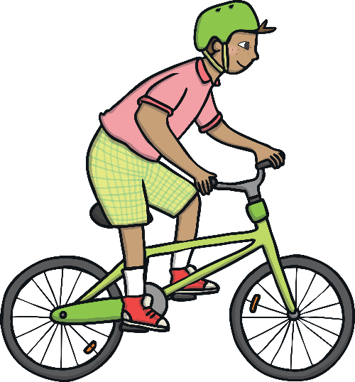
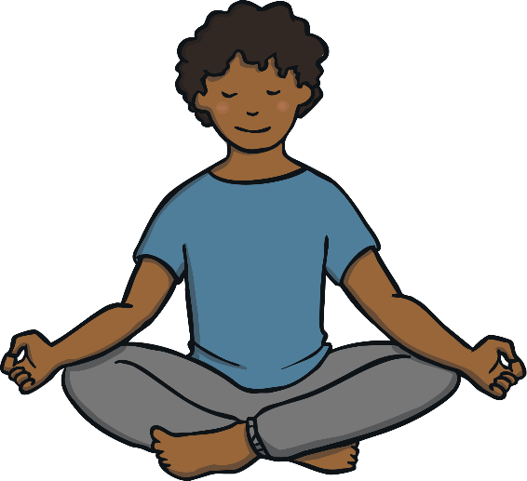
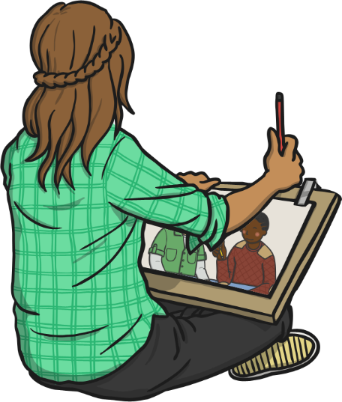
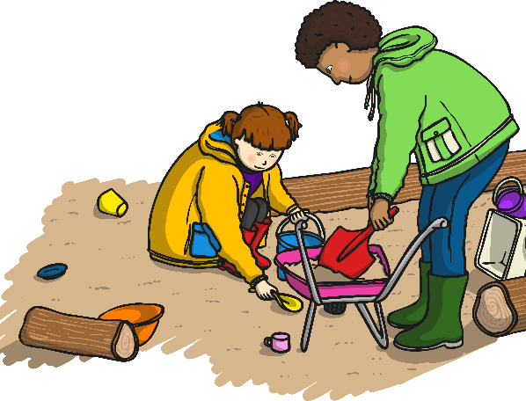
How Can We Look after Our Mental Health?
Just like with our body, it is important that we do things to help our minds to be healthy, be in good condition and feel well.
How many different things can you spot that we can do to look after our mental health?

Slide 8
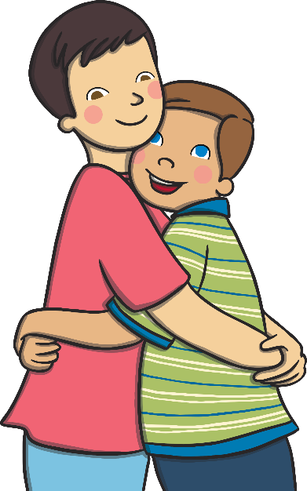
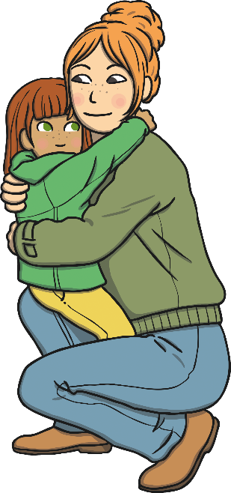
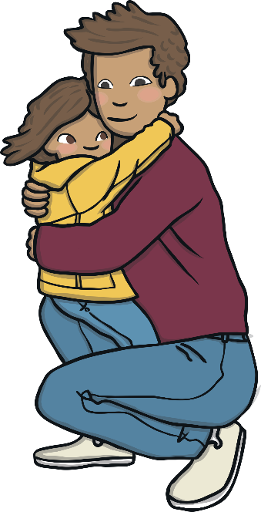
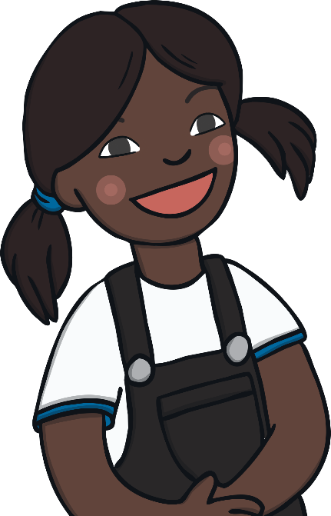
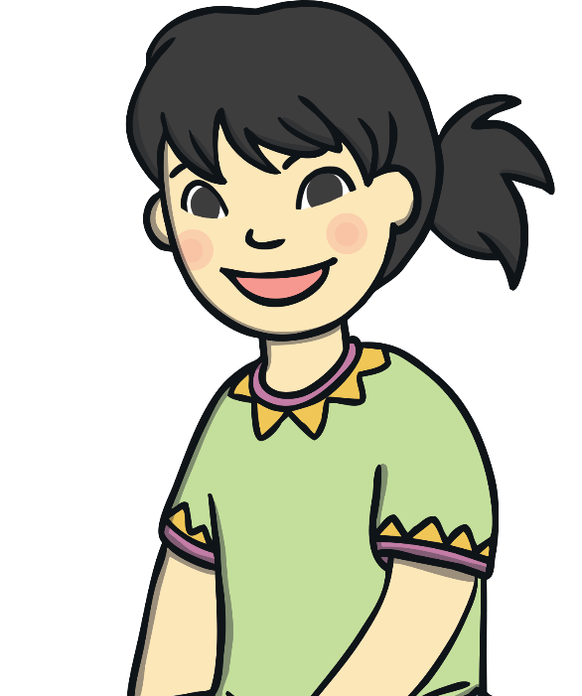
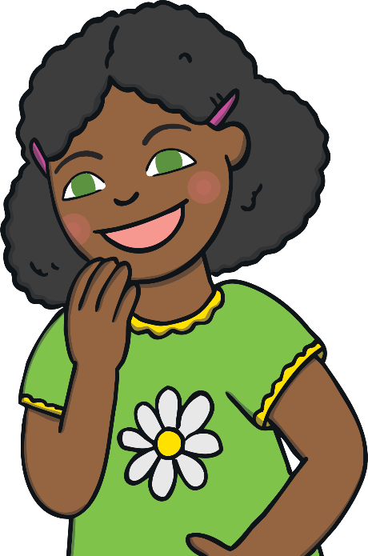
How Can We Look after Our Mental Health?
Just like with our body, it is important that we do things to help our minds to be healthy, be in good condition and feel well.
How many different things can you spot that we can do to look after our mental health?

Slide 9
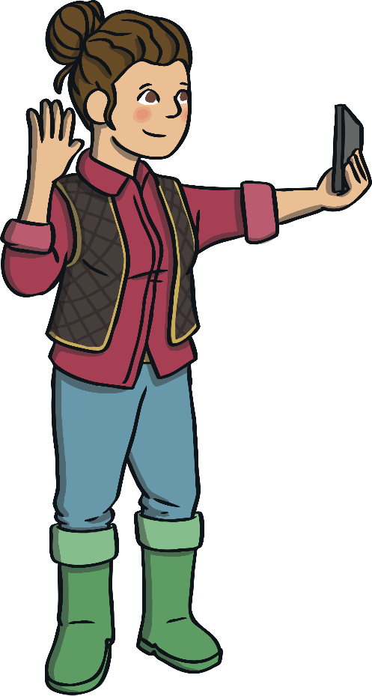
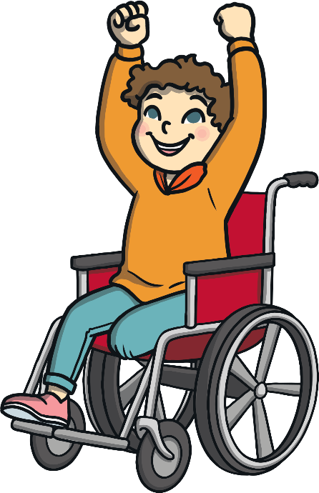
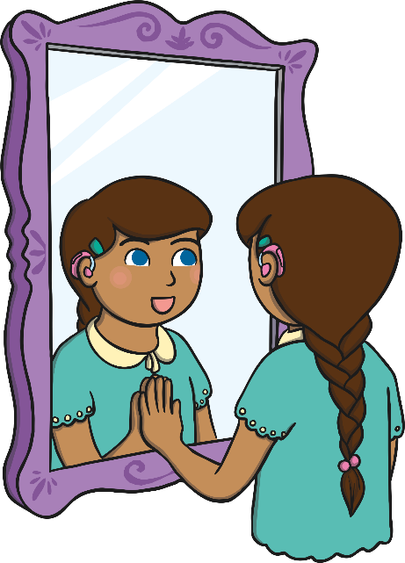
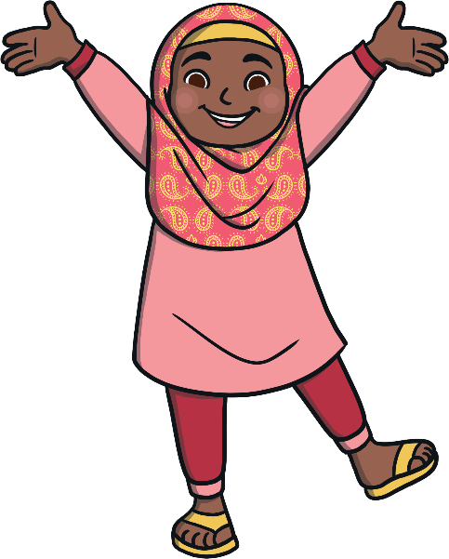
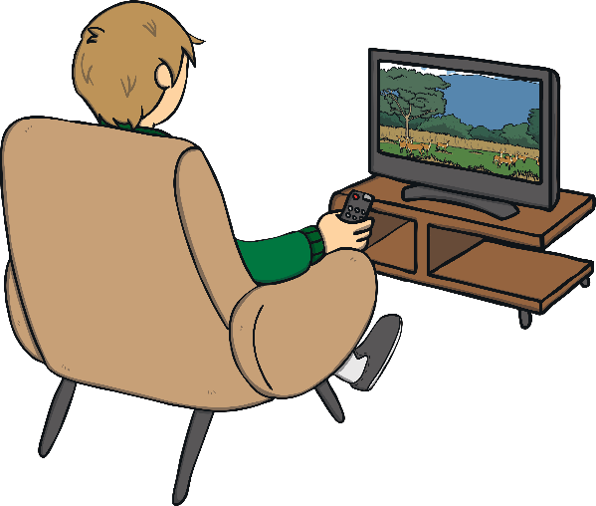
How Can We Look after Our Mental Health?
Just like with our body, it is important that we do things to help our minds to be healthy, be in good condition and feel well.
How many different things can you spot that we can do to look after our mental health?

Slide 10
How Can We Look after Our Mental Health?
How did you do?
To look after our mental health we can:
be physically active
get enough sleep
ask for help when something is troubling us
make sure we have time each day to be calm and quiet
drink plenty of water
talk about our feelings with someone we trust
eat a balanced diet

Slide 11
How Can We Look after Our Mental Health?
How did you do?
To look after our mental health we can:
spend time outside
spend time doing something we love
help and be kind to others
spend time with people who make us smile
remember we are valuable and worthy just the way we are
limit our time watching TV or on social media, the Internet and electronic devices
be creative

Slide 12
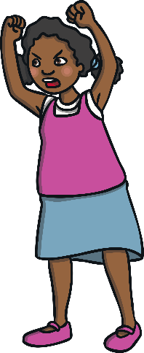
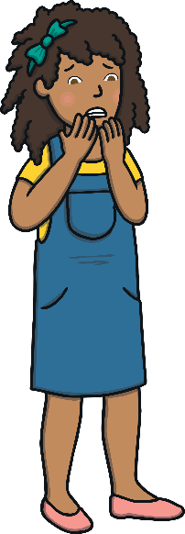
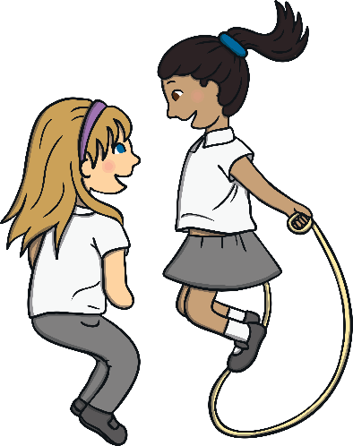
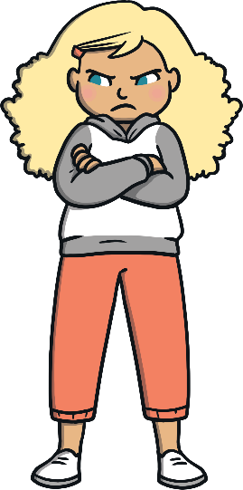
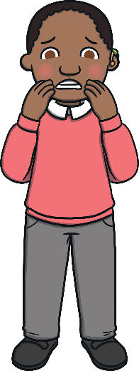
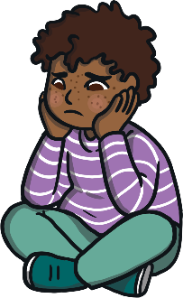
It’s OK Not to Be OK
Sometimes, we all experience uncomfortable feelings and that’s OK.
What uncomfortable feelings, as humans, can we experience?
Sometimes, life can be hard. Things can happen which really challenge us. What could you do in times like these to help you feel better?

Slide 13
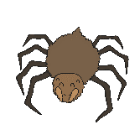
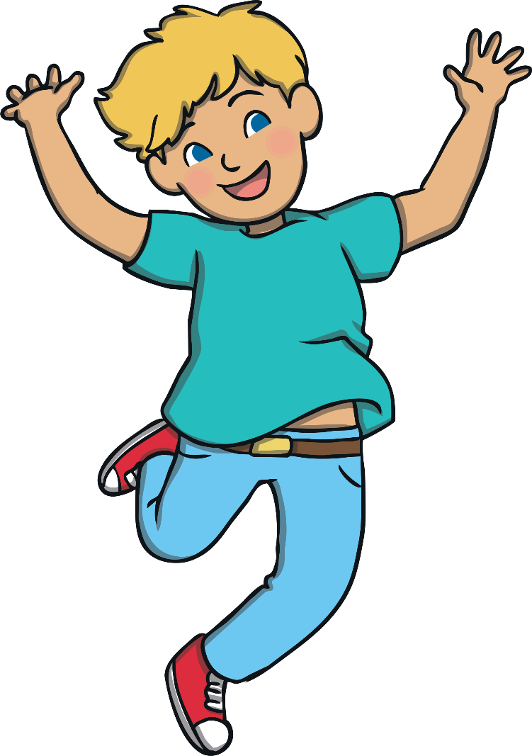
Finding Your Brave
What does ‘being brave’ mean to you?
Bravery is when someone shows mental or moral strength to face danger, fear or tricky times.

Slide 14
Finding Your Brave
We can all try to ‘find our brave’ during tricky times.
Being brave during tough times doesn’t mean holding it all in, not crying or pretending you are OK.
It means talking to an adult you trust about how you are really feeling, sharing any worries you have and asking for help. This is one of the bravest things you can do.

Slide 15
Finding Your Brave
We can all try to ‘find our brave’ during tricky times.
Being brave can also mean saying ‘no’ to something that isn’t good for our physical or mental health.
No!
Being brave can also mean you have a go at something new. This could be joining a new sports club or learning a new skill.

Slide 16
Finding Your Brave
We can all try to ‘find our brave’ during tricky times.
It can also mean stepping outside of your comfort zone and challenging yourself.

Slide 17
Finding Your Brave
Being brave when we are worried can help us feel better and feel good about ourselves.
Remember, it is not about dealing with tricky times alone or not facing them at all.

Slide 18
Finding Your Brave
It is about sharing our worries and fears, asking for help and working with others to find a positive way forward to overcome any challenges we face.

Slide 19
Offering Support
How does it feel when someone helps you with something you are finding tricky?
It feels good to give and receive help.
What could we do to help people we know to ‘find their brave’?

Slide 20
Getting Help
How does it feel when someone helps you with something you are finding tricky?
It is important for anyone struggling with their mental health to get help to feel better, just like they would with their physical health.
There is a lot we can do to help ourselves feel better but sometimes further help from others is needed.

Slide 21
Getting Help
We can talk to someone we trust and if we are a child, we can talk to a trusted adult in our family or at school.
We can talk to our doctor.

Slide 22
Getting Help
We can call ChildLine on 0800 1111.
We can call 999 if we are in immediate danger.

Slide 23
Reflection
Being kind to all people helps us, and them, to feel good on the inside and this can help us all to ‘find our brave’.
In this moment of quiet:
think about anyone who you could show kindness to;
think about anyone facing challenges that you could help them to overcome;
think about anything you would like to ‘find your brave’ with and think of someone you could talk to about it.

Slide 24
Reflection
Let’s work together and help each other ‘find our brave’!

