Slide 1

Bus Safety – Post-Primary Years 1-7
Be Smart, Be Safe, Be School Bus Aware
Notes:
SLIDE 1
BUS SAFETY AWARENESS YEAR 1 – YEAR 7.
This presentation was created by DfI Road Safety Promotion and Outreach. The presentation is aimed at pupils in Primary Years 1 to 7. The purpose of the presentation is to educate children about road safety issues associated with bus travel on route to and from school. It will also raise their awareness of the the dangers encountered as a pedestrian both before and after the journey.
Everyone is a road user. During this presentation we will explore what measures we can take to ensure our safety.
The majority of school bus-related collisions occur before boarding or soon after leaving the bus. Children need to stay alert and be aware of their surroundings to stay safe.
You are encouraged to establish any relevant history of incidents (or near misses) involving pupils from the school prior to delivering the presentation as this information will help you make the messages feel more relevant and real to your pupils. Where possible put situations in context by using recognisable place/street names to make it more real for the children.
Avoid causing undue stress by stating at the start of the lesson that if they, their family or friends have been involved in a collision or affected in any way and feel uncomfortable during the presentation that have the option to leave the room and await a member of staff.
Even if you travel to school daily on the bus you must always be alert and aware of your surroundings and ensure that you stay safe.
Not paying attention could result in a serious collision that would cause devastating consequences for you, your friends/family, and the whole school community. It only takes a moment’s lapse of concentration to cause death or serious injury.
Always expect the unexpected and never take risks while travelling by bus or crossing the road.
Discussion Questions:
What do you think bus safety means?
Who is responsible for road safety?
What does road safety mean to you?
What do you think are the most important road safety issues?
Does your school participate in Cycling Proficiency Scheme (CPS) and are the children keen to participate?
Do any of the children remember having a road safety presentation at primary or nursery school?
If yes – what did they learn and/or remember?
Do pupils have any experiences they want to talk about and share with the class/group?

Slide 2

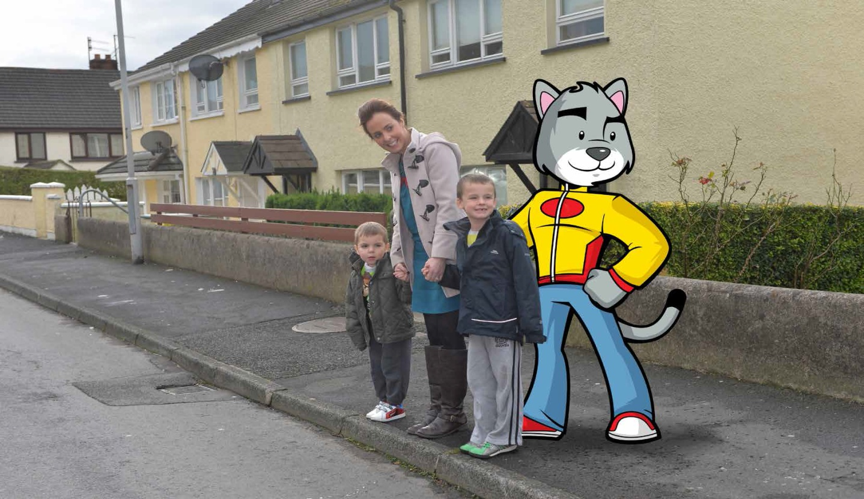
Walking to the bus stop
Mum and Skooter are teaching the children to Stop, Look and Listen
Notes:
SLIDE 2
En route to the bus stop young children should always be accompanied by an adult.
Children should be taught to keep hold of the adult’s hand, with the child furthest away from the kerb.
Always walk and don’t run in order to keep safe.
Remember the Green Cross Code before crossing any road. Young children should be taught the simplified version of ‘Stop, Look and Listen!’ whilst children from the age of eight years of age should know and understand the six steps:
1. Find a safe place to cross;
2. Stop just before you get to the kerb;
3. Look all around for traffic and listen;
4. If traffic is coming, let it pass;
5. When it is safe, walk straight across the road;
6. Keep looking and listening while you cross.
Why not role play this with a couple of children at the front of the room / hall and guide them through the process. Then follow it up by taking the time to practise it with your class on your next walk to the library/church/etc. You should also raise the issue with your parents in the next school newsletter / website / facebook post and encourage them to practise it when out and about with their children.

Slide 3
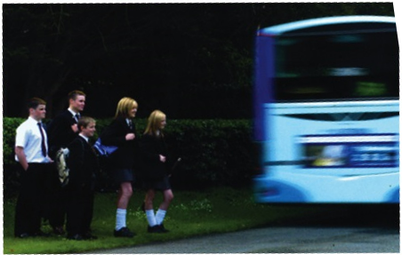
Behaviour at the Bus Stop
Make sure you have your
bus money and/or pass
Stand in a queue away
from the edge of the road
Do not play at the bus stop
When the bus arrives don't
rush or push to get on the bus
Notes:
SLIDE 3
Teachers should educate children about the importance of keeping safe when around school buses – emphasise how big these vehicles are compared to children and how difficult it is for a bus driver to see them in his mirrors.
Make sure you’ve got enough money and/or your pass for the journey.
Discuss why it is important to stay safe while at the bus stop:
– stand in a safe place (in an orderly queue), away from the road;
– do not play at the bus stop as you could end up getting hit by a vehicle if you fell onto the road.
If required, indicate to the driver you want the bus to stop by walking 2 steps forward and holding your arm out as it approaches then move back from the edge of the kerb before the bus stops.
Don’t rush or push to get on the bus - take your time - remember its important to be safe!
If your bus doesn’t turn up, don’t panic – return to school and tell the teacher.

Slide 4
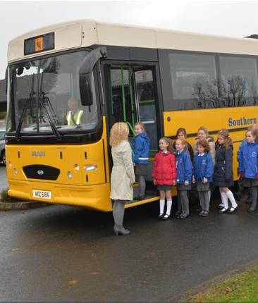
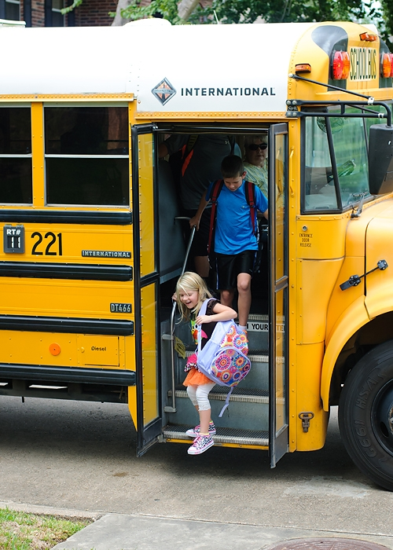
Boarding the Bus
Wait for the bus to stop and
always let passengers off first
Line up in a queue
Don't push or shove
Use the handrail
Take your seat
Fasten your seatbelt (if there is one)
Notes:
SLIDE 4
This slide demonstrates the correct way to get on and off the bus.
The picture shows the children lining up in an orderly queue.
The driver tells them when it is safe to board the bus.
Sit down and always wear a seatbelt where one is available and keep it on for the duration of the journey – only remove it and get out of your seat when the bus is stopped to avoid falling.
Children need to understand the dangers of traffic being hidden from their view by the school bus and remember it you can’t see the traffic then the drivers can’t see you.

Slide 5
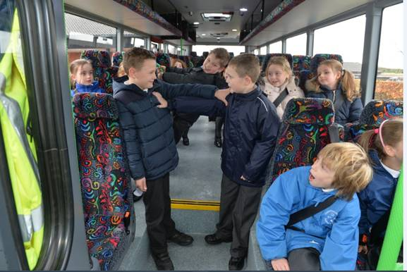
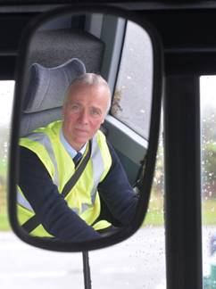
Behaviour On The Bus - Discussion
Notes:
SLIDE 5
Ask the children what the boys are doing wrong in the photograph.
Explain that the bus driver has a very important role in transporting children to and from school - he needs to concentrate on what is happening on the road at all times.
The children in the picture are not sitting in their seat with a seat belt on – instead they are misbehaving and have caused the driver to check his mirror. This means he has been distracted and is no longer able to give his full attention to what is happening on the road. This places himself, the bus passengers, and other road users in danger and it could lead to a serious collision.

Slide 6
Behaviour On The Bus
Don’t distract the driver
Don't push or shove
Store your bag safely
Never throw things on the bus or out the windows
Never play with safety equipment onboard the bus
Give your seat up for elderly and disabled people
Notes:
SLIDE 6
Discuss with the children each of the points in the attached slide and why it is important to obey these rules - for their safety and of other road users.
Get the pupils to come up with what could happen (consequences) when the opposite of each point takes place.

Slide 7
Getting off the bus
Stand behind the driver when waiting to get off the bus
Never walk in front of
or behind a bus
Wait until the bus has gone
and find a safe place to cross
Notes:
SLIDE 7
Discuss with the children each of the points in the attached slide and why it is important to obey these rules.
Never walk in front of, or behind, a bus - if you can’t see the driver then the driver cant see you!
Wait your turn to get off the bus – don’t push in case you cause a fall and injury to yourself and/or others.
Once you are off the bus, stand on the footpath and wait until the bus has moved away before attempting to cross the road.
Always use the Green Cross Code!
Although you may travel this route every day you must remain alert to stay safe.

Slide 8
Remember the following rules & travel safe
1. Signal – if you need to let the driver know you want on the bus
2. Stand back from the kerb until the bus has stopped and the door opens
3. Allow any passengers to get off
4. Don't push or shove
5. Sit down and always wear your seatbelt where one is provided
6. Store your bags safely
7. Don’t distract the driver
8. Give your seat up for the elderly and disabled
9. Wait until the bus has stopped before removing your seatbelt and leaving your seat
10. Never walk out in front of, or behind, the bus
Notes:
SLIDE 8
Summary
Teachers should remind children of the attached 10 bullet points outlining the key messages in this presentation.

